Slide 1
ENGR 301 Engineering Management Principles and Economics
Lecture 4B
COST Estimates and Project Control – Earned Value
Dr C.J. Willis, CAPM, P.Eng
‹#›

Slide 2
Why are Estimates Developed?
to obtain contracts (contractor)
to establish a budget (contractor)
to determine feasibility (designer)
control cost during design (designer)
consider alternatives (designer)
to evaluate corporate purchases (owner)
to appraise value (owner)
Dr C.J. Willis, CAPM, P.Eng
‹#›

Slide 3
Types of Estimates
Estimates for conceptual planning:
based on only general parameters of facility size, anticipated quality of construction, and use of the facility.
The primary purpose of these estimates is to provide an idea of the likely cost of the facility to determine the amount of money needed to finance the project.
Dr C.J. Willis, CAPM, P.Eng
‹#›

Slide 4
Types of Estimates
Estimates for feasibility:
based on preliminary design information and is prepared after the project scope is completely defined.
Dr C.J. Willis, CAPM, P.Eng
‹#›

Slide 5
Types of Estimates
Estimates during engineering and design:
based on schematic design documents.
The estimate is prepared based on major quantities and method of assembly/fabrication/construction that will occur on the project.
Dr C.J. Willis, CAPM, P.Eng
‹#›

Slide 6
Types of Estimates
Estimates for project execution/construction:
These are itemized cost computations based on a complete set of contract documents.
These estimates are prepared using historical average costs or by creating crews/manufacturing units and considering their production.
Dr C.J. Willis, CAPM, P.Eng
‹#›

Slide 7
Types of Estimates
Estimates for change orders:
Are developed during project implementation in response to an owner directed change in project scope.
Dr C.J. Willis, CAPM, P.Eng
‹#›

Slide 8
Contingency
Contingency is an amount added to an estimate to allow for items, for which the experience shows will likely result in additional costs.
Contingency is generally determined based on the estimator’s past project experience and considers such things as:
planning and estimating errors and omissions,
possible price escalations,
changes within the project scope
Dr C.J. Willis, CAPM, P.Eng
‹#›

Slide 9
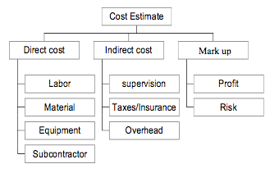
Detailed Cost Estimate
Dr C.J. Willis, CAPM, P.Eng
‹#›

Slide 10
Estimating Models, cont’d.
Triangulation
Approaching the estimate from different perspectives and sources
Using different sources to arrive at the estimate
Learning Curve
A percentage or rate (i.e. “r”) at which output is increased due to repetition
T_{2k} = T_{initial}(2k)^{b}
T_{k} = T_{initial}(k)^{b} => T_{N} = T_{Initital} x N^{b}
(T_{2k})/(T_{k}) = (2k)^{b}/(k)^{b} = 2^{b}
T_{2k} = T_{k} x 2^{b} => r = 2^{b}
T_{2k} = T_{k} x r
Where:
T_{N} or T_{k} = time required for N^{th}/k^{th} unit of production
T_{Initital} = time required for the first unit of production
N or k = number of completed units
b = learning curve exponent = log(learning curve as decimal)/log(2.0)

Slide 11
What is EVM?
Earned value management (EVM) is a project control technique
EVM integrates project scope, cost, and schedule measures to assess a project’s performance and progress.
EVM measures the performance of a project at any point in time over its duration
Achieves this by establishing a baseline referred to as the project’s cost schedule plan.
Dr C.J. Willis, CAPM, P.Eng
‹#›

Slide 12
The Cost Schedule Plan
The cost schedule plan is a plot of a project’s planned cumulative costs that serves as a basis for comparison with the actual cost of work performed and budgeted cost of work performed (i.e. earned value).
A plot of a planned cumulative costs usually takes the shape of an S and is therefore referred to as an S-curve.
planned - scheduled = budgeted
Dr C.J. Willis, CAPM, P.Eng
‹#›

Slide 13
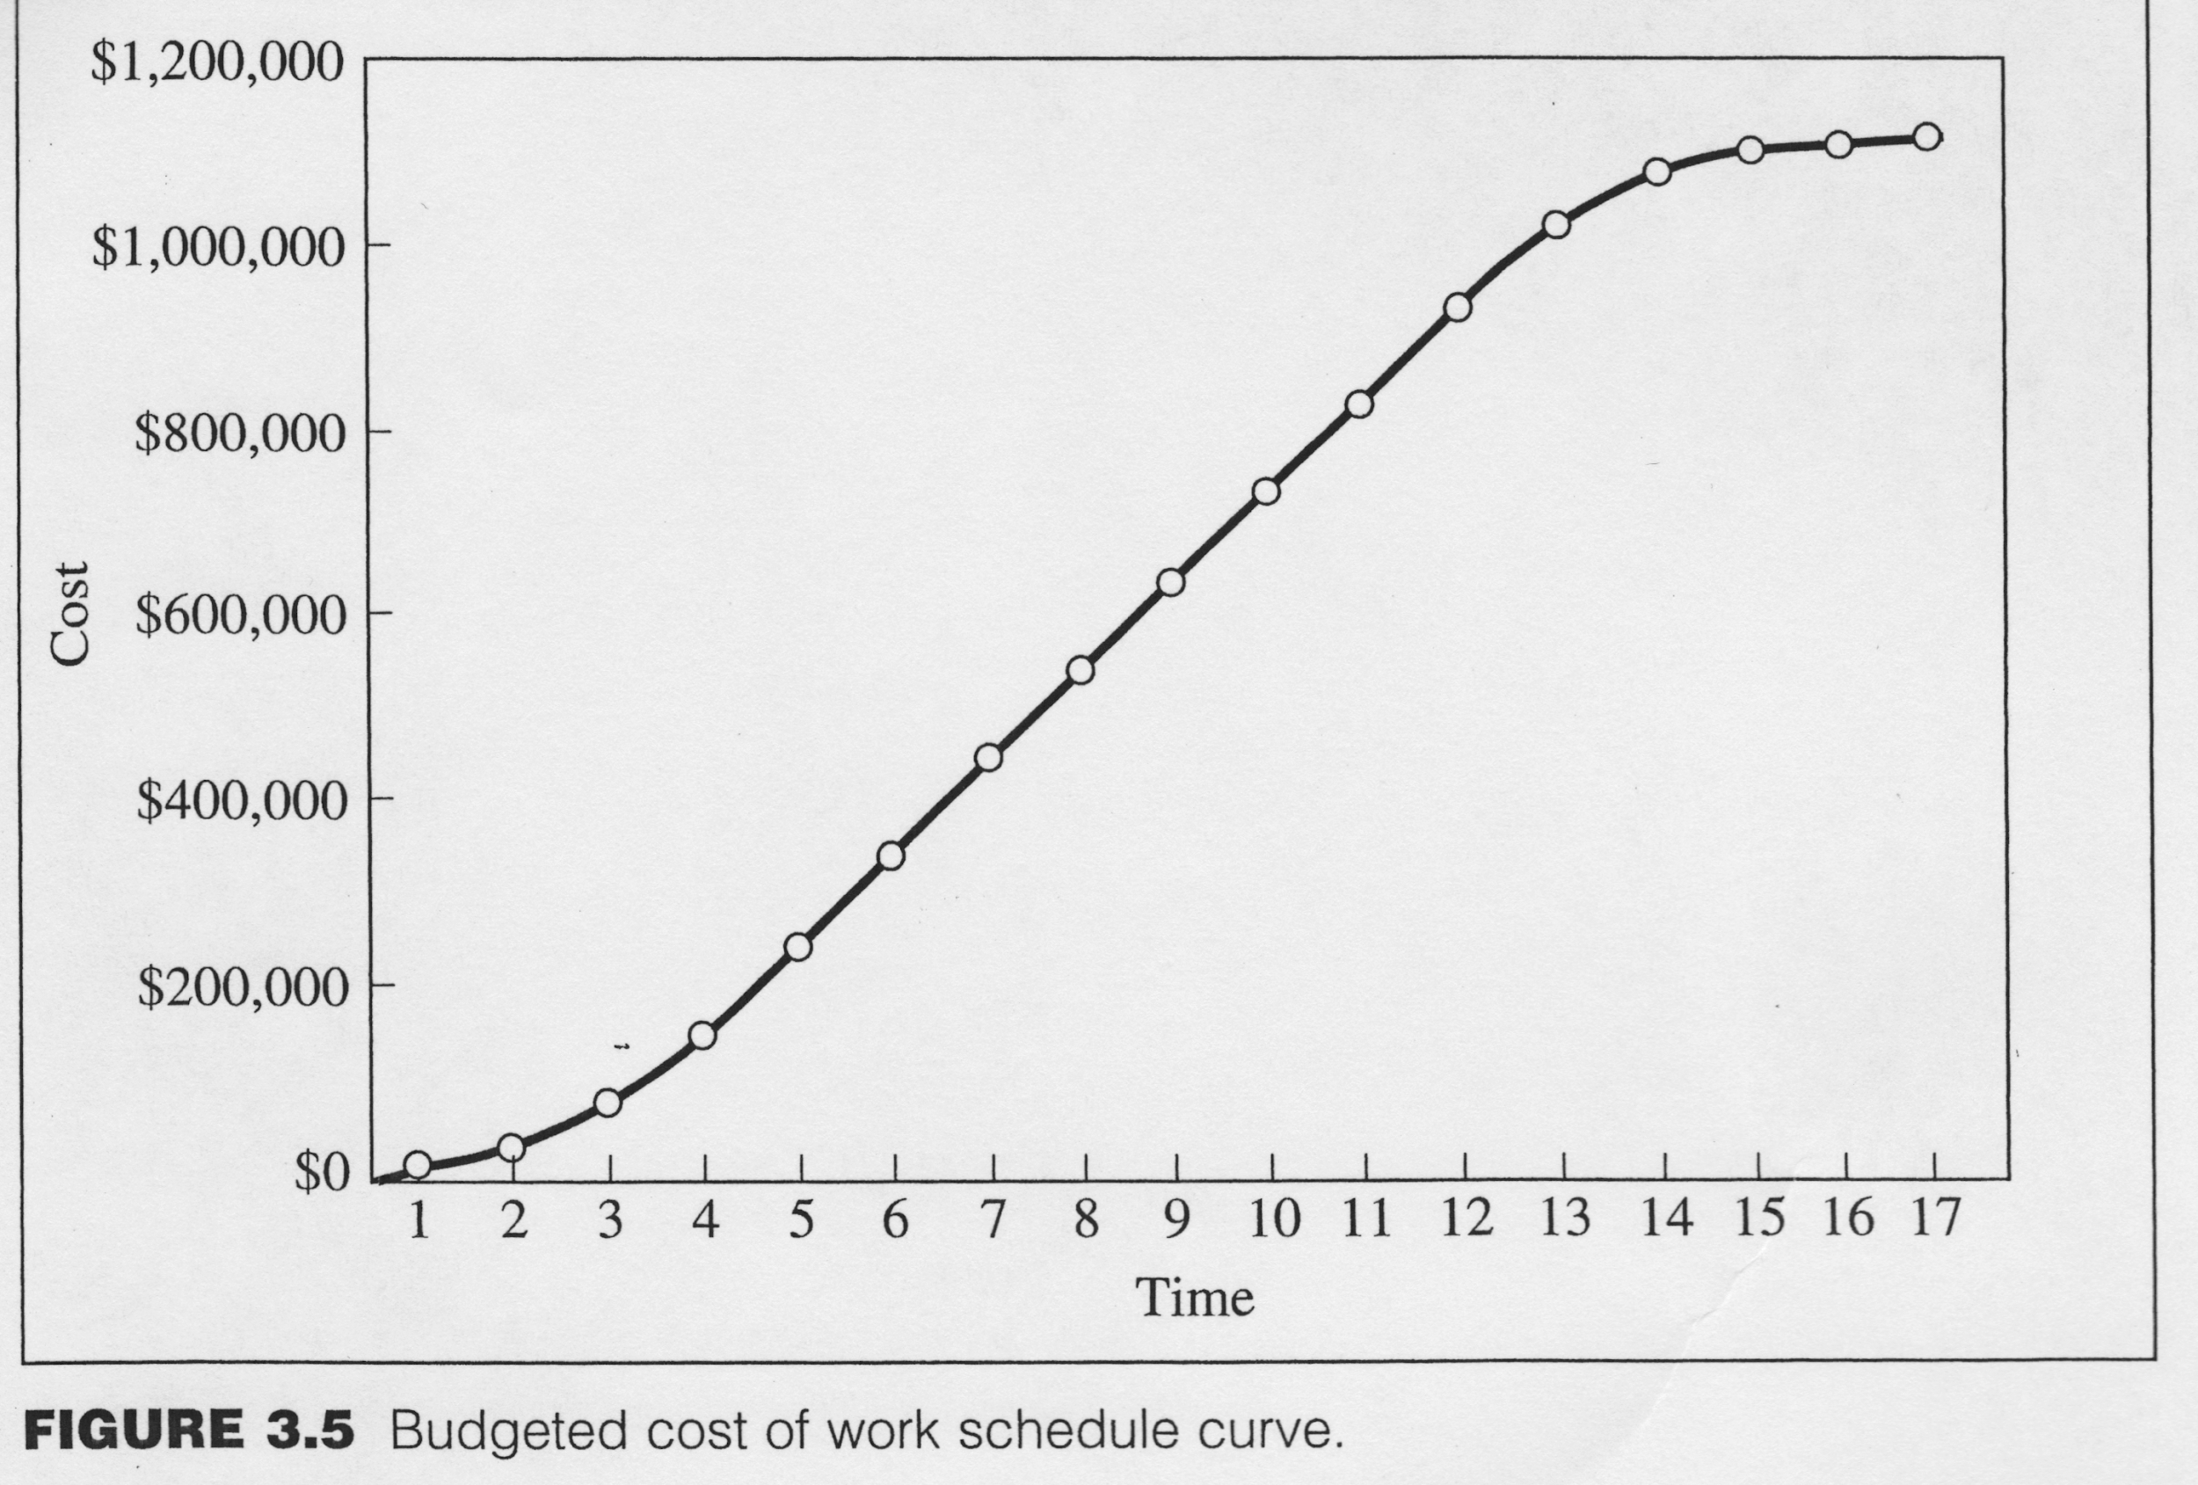
S-Curve
Dr C.J. Willis, CAPM, P.Eng
‹#›

Slide 14
Basic Concept of Control :Actual vs Budgeted
The basic concept of control is centered on comparing actual against budgeted.
Actual no. of labor hours worked vs budgeted
Actual no. of equipment hours vs budgeted
Actual material quantity and cost vs budgeted
Actual cost of preparing design drawings vs budgeted
.
.
.
etc
Dr C.J. Willis, CAPM, P.Eng
‹#›

Slide 15
Cost Control
Cost control is done to detect cost overrun
It allows for timely corrective actions to minimize or eliminate impacts of cost overrun
Cost control data is important for effective estimates and bids of new projects.
Managing changes in cost includes:
Detecting changes
Recording changes
Approving changes
Dr C.J. Willis, CAPM, P.Eng
‹#›

Slide 16
Productivity
Productivity is the most important job factor that the project team must control.
It is a “measure of the progress of work against a standard such as the project schedule”.
Dr C.J. Willis, CAPM, P.Eng
‹#›

Slide 17
S-Curve (PV Curve)
An S-curve is used as a means of predicting project cash flow requirements.
It provides an idea as to how the project budget will be spent if the work is constructed exactly as estimated and scheduled.
An S – curve is constructed by cumulatively adding the costs from the ‘work breakdown structure’ submitted to the owner according to their planned completion time .
Dr C.J. Willis, CAPM, P.Eng
‹#›

Slide 18
Earned Value (EV)
Earned Value calculations tell the project manager where a project is in terms of time and effort in the common unit of cost ($)
Represents how much of the budget should have been spent based on the actual amount of work performed.
Obtained by firstly determining actual quantities of work completed.
Earned value (EV) = % complete x total budgeted cost
Dr C.J. Willis, CAPM, P.Eng
‹#›

Slide 19
Earned Value (EV)
Earned Value Terminology
Budgeted Cost of Work Scheduled (BCWS) or Planned Value (PV)
Budgeted Cost of Work Performed (BCWP) or Earned Value (EV)
Actual Cost of Work Performed (ACWP) or Actual Cost (AC)
Budget at Completion (BAC)
Cost Variance (CV)
Schedule Variance (SV)
Cost Performance Index (CPI)
Schedule Performance Index (SPI)
estimated (remaining cost) to completion (ETC)
projected (total cost) estimated at completion (EAC)
Dr C.J. Willis, CAPM, P.Eng
‹#›

Slide 20
Budgeted Cost of Work Scheduled (BCWS) or Planned Value (PV)
Is how much of the budget should have been spent, in view of the “baseline cost of work” (planned cost of work).
If the amount of the expenditures (i.e. costs) was exactly as planned, and the timing of these expenditures occurred exactly as planned (scheduled), then money would be spent as per the BCWS curve.
The PV curve represents planned expenditures at planned times.
Dr C.J. Willis, CAPM, P.Eng
‹#›

Slide 21
Budgeted Cost of Work Scheduled (BCWS)
Determined by:
Using a work breakdown structure, define the project into definable activities
Plan and schedule the project
Assign resources and their associated costs
Create the baseline or S-curve by adding planned costs over the project duration
Dr C.J. Willis, CAPM, P.Eng
‹#›

Slide 22
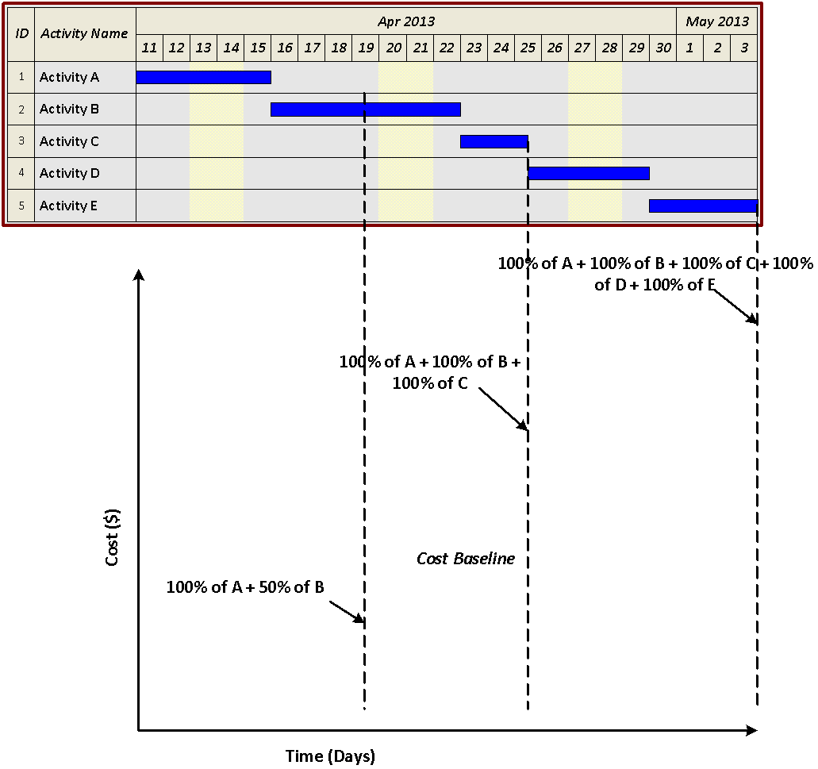
Example of a Project’s Cumulative Cost Curve
Dr C.J. Willis, CAPM, P.Eng
‹#›

Slide 23
Actual Cost of Work Performed (ACWP) or Actual Cost (AC)
Is the actual costs incurred for work actually performed.
It represents what actually happened, i.e. actual expenditures at the actual time they occurred.
Dr C.J. Willis, CAPM, P.Eng
‹#›

Slide 24
Cost Variance (CV)
Is Budgeted Cost of Work Performed – Actual Cost of Work Performed.
Cost Variance = BCWP – ACWP =EV-AC
If the CV is positive, the cost is currently under the budgeted (or baseline) amount;
If the CV is negative, the task is currently over budget.
Dr C.J. Willis, CAPM, P.Eng
‹#›

Slide 25
Schedule Variance (SV)
Is Budgeted Cost of Work Performed – Budgeted Cost of Work Scheduled.
Schedule Variance = BCWP – BCWS=EV-PV
If the SV is positive, the project is ahead of schedule in cost terms;
If the SV is negative, the project is behind schedule in cost terms
Dr C.J. Willis, CAPM, P.Eng
‹#›

Slide 26
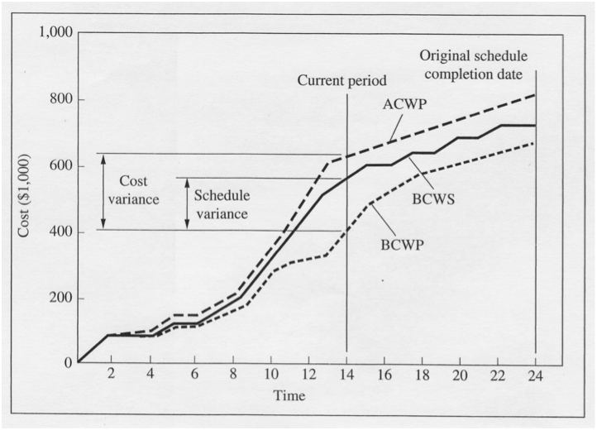
Dr C.J. Willis, CAPM, P.Eng
‹#›

Slide 27
CPI and SPI
An alternative to Cost Variance and Schedule Variance is the Cost Performance Index (CPI) and Schedule Performance Index (SPI)
CPI = ^{EV}/_{AC} or (BCWP/ACWP)
SPI = ^{EV}/_{PV} or (BCWP/BCWS)
These are more useful for making comparisons at different points in time, or across different projects, or among different project managers
For CPI and SPI, values less than 1 are undesirable
Dr C.J. Willis, CAPM, P.Eng
‹#›

Slide 28
Estimated Remaining Cost to Completion ETC
ETC can be calculated using one of two expressions:
1. TYPICAL Assumption
(1) ETC = ^{(BAC – EV)}/CPI, BAC is the budget at completion
Or equivalently: ETC=BAC . ( AC/EV) – AC
AC/EV=1/CPI Cost Inefficiency
This approach is used when current variances are seen as typical of future variances. therefore work will be completed at the same level of efficiency or inefficiency done so far.
Dr C.J. Willis, CAPM, P.Eng
‹#›

Slide 29
Projected Total Cost at Completion
The projected total cost estimated at completion is given by:
EAC = ETC + AC
Or equivalently:
EAC=BAC X AC/EV= BAC /CPI
Dr C.J. Willis, CAPM, P.Eng
‹#›

Slide 30
2. ATYPICAL ASSUMPTION:
(2) ETC = BAC – EV
This approach is used when current variances are seen as ‘atypical’ of future variances. It therefore assumes that current variances will not continue in the future

Slide 31
Earned Value (Example)
A project that has a total cost of $2,350,000 and has an actual cost [Cumulative] at month 5 of $710,000. Its scheduled cost [Cumulative] at month 5 is $650,000. If the project’s duration is planned to be 180 days and the % complete at month 5 is 29%, find:
The earned value
Cost and schedule variances (CV and SV)
CPI and SPI
Projected total cost at completion (EAC) and estimated duration
Dr C.J. Willis, CAPM, P.Eng
‹#›

Slide 32
Solution:
EV = BCWP = % complete x BAC
29% x $2,350,000 = $681,500
ACWP = $710,000
BCWS = $650,000
Cost Variance (CV) = BCWP – ACWP=EV-AC
= $681,500 - $710,000 = -$28,500 (-ive meaning the project is currently over budget)
Schedule Variance (SV) = BCWP – BCWS=EV-PV
= $681,500 - $650,000 = $31,500 (+ive meaning the project is ahead of schedule)
Dr C.J. Willis, CAPM, P.Eng
‹#›

Slide 33
CPI = ^{EV}/_{AC} = ^{BCWP} / _{ACWP} =^{$681,500} / _{$710,000} = 0.96
SPI = ^{EV}/_{PV =} ^{BCWP} _{/ BCWS} = ^{$681,500} / _{$650,00} = 1.05
Estimated duration of the project = 180/1.05 = 171 days
Dr C.J. Willis, CAPM, P.Eng
‹#›

Slide 34
Projected total cost at completion (EAC)
Assuming that current variances are atypical, i.e. they will not continue in the future
use (ETC) = (BAC – EV)
= $2,350,000 - $681,500 = $1,668,500
Therefore EAC = ETC + AC (or ACWP)
= $1,668,500 +$710,000 = $2,378,500
Dr C.J. Willis, CAPM, P.Eng
‹#›

